Slide 1
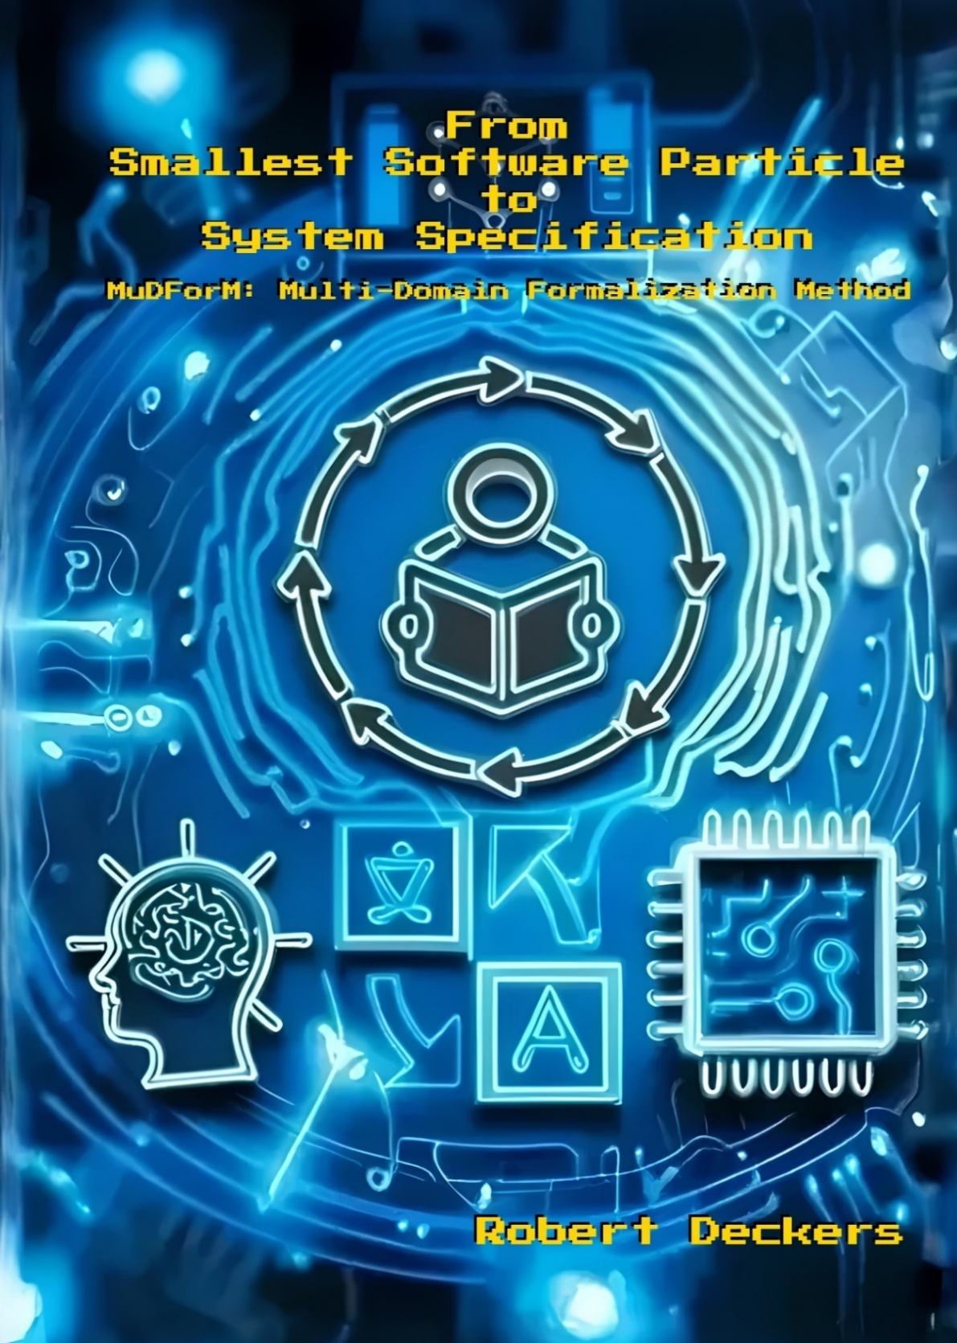



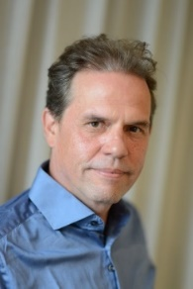
Een methode om
kennis en beslissingen
vast te leggen
van alle betrokkenen
bij softwareontwikkeling
Atom Free IT
20241112 v4
Notes:
10 jaar in 10 minuten.

Slide 2
Bij de geldautomaat…
Er zijn geldautomaten.
class Geldautomaat:
def __init__(self, saldo_geldautomaat):
self.saldo_geldautomaat = saldo_geldautomaat
def controleer_saldo_geldautomaat(self):
print(f"Saldo geldautomaat is: €{self.saldo_geldautomaat}")
def opnemen(self, rekening, bedrag):
if bedrag > self.saldo_geldautomaat:
print("Geldautomaat heeft onvoldoende saldo!")
elif bedrag > rekening.saldo:
print("Rekening heeft onvoldoende saldo!")
else:
rekening.saldo -= bedrag
self.saldo_geldautomaat -= bedrag
print(f"€{bedrag} is opgenomen. Je nieuwe rekeningsaldo is: €{rekening.saldo}")
print(f"Nieuw saldo van de geldautomaat is: €{self.saldo_geldautomaat}")
class Rekening:
def __init__(self, beginsaldo):
self.saldo = beginsaldo
def controleer_saldo(self):
print(f"Je rekeningsaldo is: €{self.saldo}")
Bedrag opnemen van rekening.
Maar ook:
PIN code controleren
Traceerbaar
Gebruiksvriendelijk
Meer talen
Omgaan met kapotte hardware
Verminder rekeningsaldo met bedrag.
Notes:
First, let me tell you a bit how software is developed nowadays.

Slide 3
Bij een iets realistischere geldautomaat…
import time
from datetime import datetime
class ATM:
def __init__(self, atm_balance):
self.atm_balance = atm_balance
self.transactions = []
self.is_operational = True # Simulate ATM operational status
def check_atm_balance(self):
print(f"ATM balance is: ${self.atm_balance}")
def verify_pin(self, account, entered_pin):
return account.pin == entered_pin
def withdraw_cash(self, account, amount, entered_pin):
if not self.is_operational:
print("ATM is currently out of service. Please try again later.")
return
start_time = time.time()
if not self.verify_pin(account, entered_pin):
print("Incorrect PIN!")
return
if amount > self.atm_balance:
print("ATM has insufficient funds! Please try a smaller amount or visit another ATM.")
return
if amount > account.balance:
print("Account has insufficient funds! Please check your balance or deposit more funds.")
return
if time.time() - start_time > 2:
print("Please wait...")
return
self.atm_balance -= amount
account.balance -= amount
transaction = {
'account_id': account.account_id,
'amount': amount,
'timestamp': datetime.now().isoformat()
}
self.transactions.append(transaction)
print(f"${amount} has been withdrawn. Your new account balance is: ${account.balance}")
print(f"ATM new balance is: ${self.atm_balance}")
def print_transactions(self):
for transaction in self.transactions:
print(transaction)
class Account:
def __init__(self, account_id, initial_balance, pin):
self.account_id = account_id
self.balance = initial_balance
self.pin = pin
def check_balance(self):
print(f"Your account balance is: ${self.balance}")
# Multilingual support
messages = {
'en': {
'atm_balance': "ATM balance is: ${}",
'incorrect_pin': "Incorrect PIN!",
'atm_insufficient_funds': "ATM has insufficient funds! Please try a smaller amount or visit another ATM.",
'account_insufficient_funds': "Account has insufficient funds! Please check your balance or deposit more funds.",
'please_wait': "Please wait...",
'withdraw_success': "${} has been withdrawn. Your new account balance is: ${}",
'atm_new_balance': "ATM new balance is: ${}",
'atm_out_of_service': "ATM is currently out of service. Please try again later."
},
'nl': {
'atm_balance': "ATM-saldo is: ${}",
'incorrect_pin': "Onjuiste pincode!",
'atm_insufficient_funds': "ATM heeft onvoldoende saldo! Probeer een kleiner bedrag of bezoek een andere ATM.",
'account_insufficient_funds': "Rekening heeft onvoldoende saldo! Controleer uw saldo of stort meer geld.",
'please_wait': "Even geduld aub...",
'withdraw_success': "${} is opgenomen. Uw nieuwe rekeningsaldo is: ${}",
'atm_new_balance': "Nieuw ATM-saldo is: ${}",
'atm_out_of_service': "ATM is momenteel buiten dienst. Probeer het later opnieuw."
}
}
Maar ook:
Voldoen aan bank- en privacy wetgeving
Geld storten, saldo bekijken, biljetten kiezen, etc..
Unformiteit garanderen voor alle financiele transacties, zoals online betalen, geld overmaken.
En meer…

Slide 4

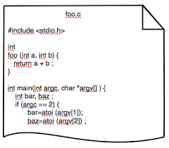
Wat is er aan de hand?
Geldautomaat gebruiker
Veel verschillende vakgebieden en mensen met hun eigen taal.
Te moeilijk om allemaal te begrijpen voor de programmeur.
Bankmanager
Overheid
UI expert
Personeelszaken
De juiste software maken is moeilijk.
Software voldoet niet.
Beveiligings- expert
Project-management
Netwerkbeheerder

Slide 5


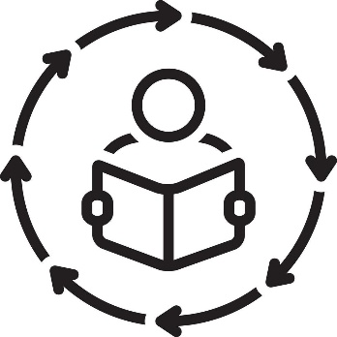

Doel van onderzoek
Methode: taal, stappen, en richtlijnen → Systematisch process
Duidelijke specificaties van kennis en beslissingen
→Bruikbaar voor software
Gebaseerd op hoe mensen denken en communiceren
Voor alles en iedereen
Mensentaal
Aangepakt via 5 onderzoeksvragen
Notes:
Investigate a software development process, in which the knowledge and decisions of all involved people can be captured and integrated systematically,

Slide 6

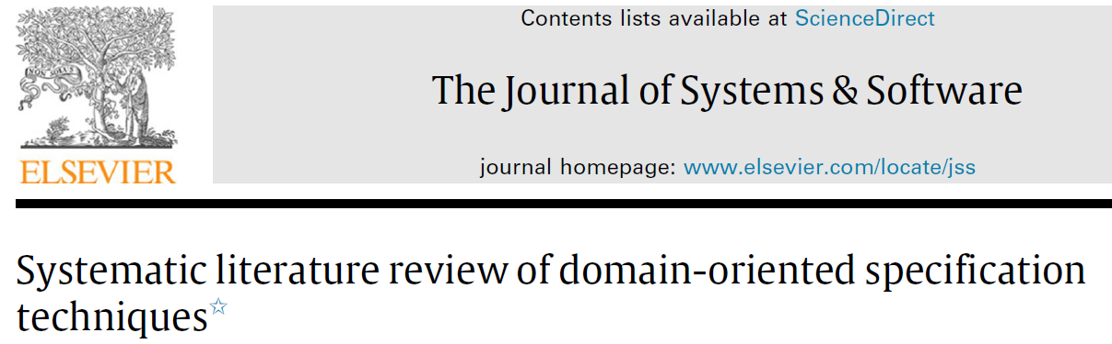

Bestuderen wat er is (onderzoeksvraag 1)
Meer dan 10 boeken en 200 artikelen
1. Bruikbare onderdelen
2. Gaten → Andere onderzoeksvragen

Slide 7
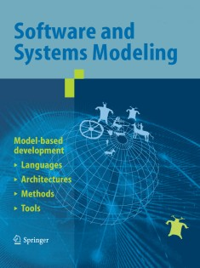
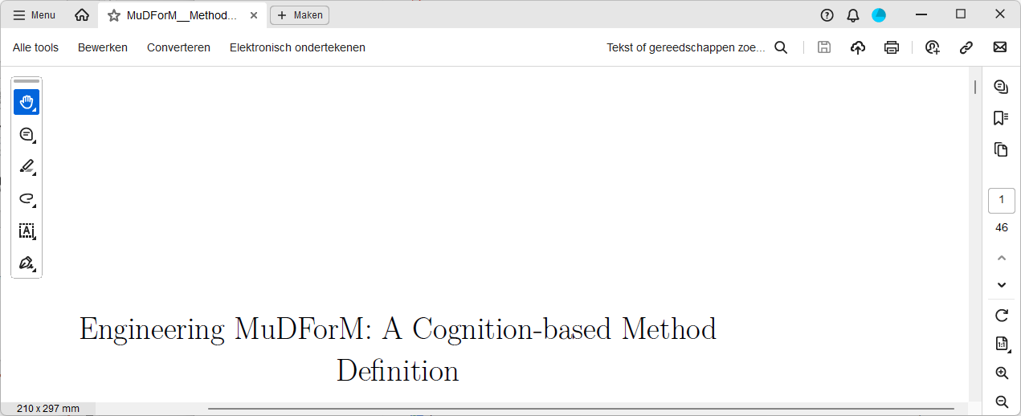
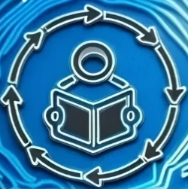

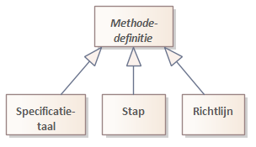
Definieer methode (onderzoeksvraag 2)
MuDForM
Bestaande methodes
Under submission
30 jaar ervaring

Slide 8
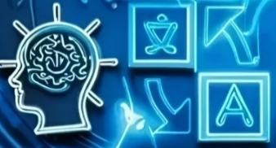
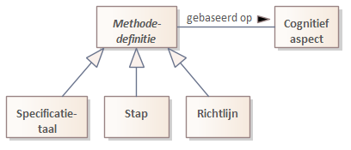
Verbinden aan denken en communiceren (onderzoeksvraag 5)
Cognition perspective on MuDForM
Analyse en reflectie vanuit meer dan 150 boeken
(taal)filosofie, linguistiek, cognitieve psychologie, …

Slide 9

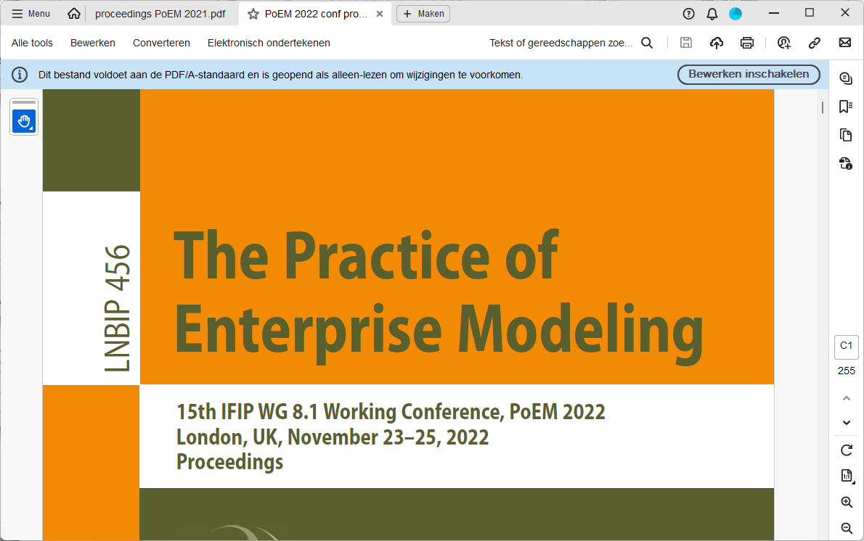
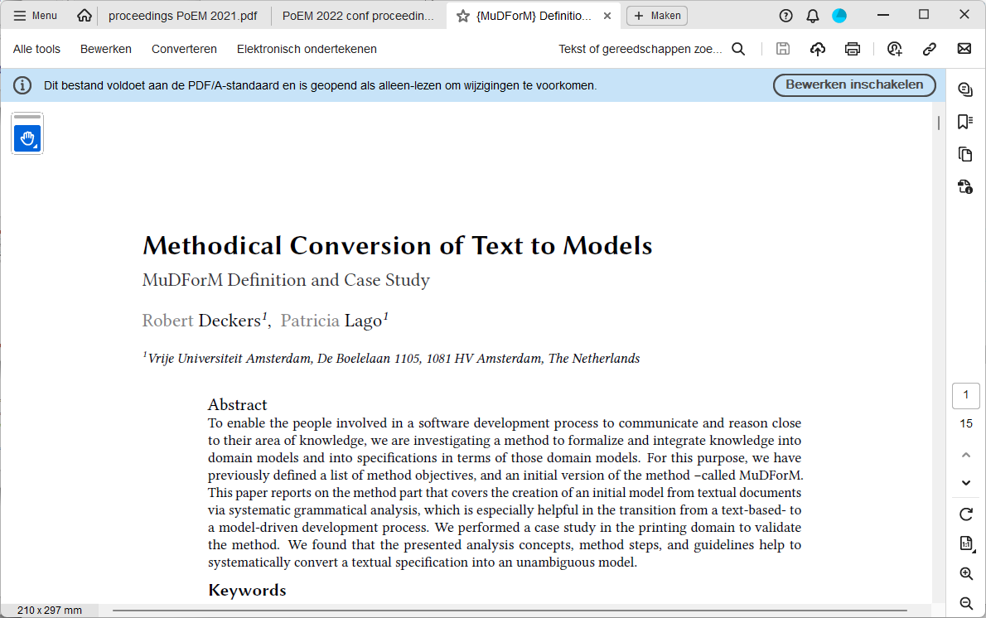


Software maken van mensentaal (onderzoeksvraag 3)
Geld opnemen, rekeningsaldo, privacy
Geldautomaat gebruiker
Wetboek, artikel aansprakelijkheid, traceerbaarheid
Bedrijfsmodel, omzet, rentestand, financiering
Overheid
Bankmanager
Toegang, help, data invoeren
UI expert
Personeelszaken
Medewerker, opleiding, ervaring, vaardigheid
Asset, maatregel, schade, aanval, kwetsbaarheid
Geld opnemen
Beveiligings- expert
Project-management
van
bij
Netwerkbeheerder
Project, mijlpaal, taak, oplevering
Rekening
Geld-autom.
knoop, latency, encryptie, redundantie
Notes:
The starting point is human language. So, I investigated how humang language can be transformed into somethin that a computer can process.
This means capturing the vocabulary of all involved people.

Slide 10

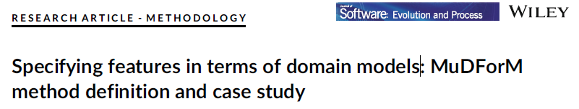










Beslissingen vastleggen in specificaties (onderzoeksvraag 4)
Geld opnemen, rekeningsaldo, privacy
$
Winst
Art. 4.11
Geldautomaat gebruiker
t
Wetboek, artikel aansprakelijkheid, traceerbaarheid
Bedrijfsmodel, omzet, rentestand, financiering
Overheid
Bankmanager
Project leader
Software engineer
Tester
Toegang, help, data invoeren
UI expert
Personeelszaken
Medewerker, opleiding, ervaring, vaardigheid
Asset, maatregel, schade, aanval, kwetsbaarheid
Beveiligings- expert
Project-management
+many previous projects
Netwerkbeheerder
Project, mijlpaal, taak, oplevering
knoop, latency, encryptie, redundantie

Slide 11

Effect: specificatie = software
Geld opnemen, rekeningsaldo, privacy
$
Winst
Art. 4.11
Geldautomaat gebruiker
t
Wetboek, artikel aansprakelijkheid, traceerbaarheid
Bedrijfsmodel, omzet, rentestand, financiering
Overheid
Bankmanager
Programmeur vertaalt
alleen de methode
Project leader
Software engineer
Tester
Toegang, help, data invoeren
UI expert
Personeelszaken
Medewerker, opleiding, ervaring, vaardigheid
Asset, maatregel, schade, aanval, kwetsbaarheid
Beveiligings- expert
Project-management
Netwerkbeheerder
Project, mijlpaal, taak, oplevering
knoop, latency, encryptie, redundantie

Slide 12
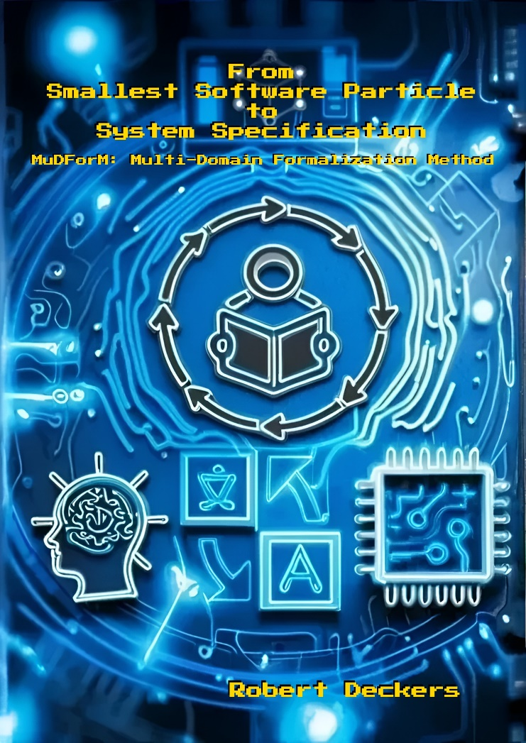
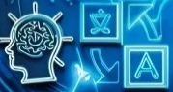
Introductie, visie → Hst1
Hst2
Hst3
Under submission
Hst4
Hst5
Volledige methodedefinitie, achtergrond data, en case studies op: https://github.com/robertdeckers/MuDForM
Report: Cognitive perspective on MuDForM
Hst6
Conclusie, discussie, open punten → Hst7
Notes:
To do: add pictures and animation using the icons form the cover.

Slide 13
Dank U

Slide 14
A method to capture
knowledge and decisions
of all people involved
in software development
Atom Free IT
20241112 v4
Notes:
I will now tell you in ten minutes what I have been doing in the last ten years.
In one sentence: I have been busy with a method for systematically capturing the knowledge and decisions of all people involved in software development.

Slide 15
At the ATM...
There are ATMs.
class ATM:
def __init__(self, atm_balance):
self.atm_balance = atm_balance
def check_atm_balance(self):
print(f"ATM balance is: ${self.atm_balance}")
def withdraw(self, account, amount):
if amount > self.atm_balance:
print("ATM has insufficient funds!")
elif amount > account.balance:
print("Account has insufficient funds!")
else:
account.balance -= amount
self.atm_balance -= amount
print(f"${amount} has been withdrawn. Your new account balance is: ${account.balance}")
print(f"ATM new balance is: ${self.atm_balance}")
class Account:
def __init__(self, initial_balance):
self.balance = initial_balance
def check_balance(self):
print("Your account balance is: ${self.balance}")
Withdraw money amount from an account.
But also:
PIN verification
Traceable
User friendly
Multiple languages
Dealing with broken hardware
Decrease account balance with amount.
Notes:
First, let me tell you a bit how software is developed nowadays.

Slide 16
At a bit more realistic ATM...
import time
from datetime import datetime
class ATM:
def __init__(self, atm_balance):
self.atm_balance = atm_balance
self.transactions = []
self.is_operational = True # Simulate ATM operational status
def check_atm_balance(self):
print(f"ATM balance is: ${self.atm_balance}")
def verify_pin(self, account, entered_pin):
return account.pin == entered_pin
def withdraw_cash(self, account, amount, entered_pin):
if not self.is_operational:
print("ATM is currently out of service. Please try again later.")
return
start_time = time.time()
if not self.verify_pin(account, entered_pin):
print("Incorrect PIN!")
return
if amount > self.atm_balance:
print("ATM has insufficient funds! Please try a smaller amount or visit another ATM.")
return
if amount > account.balance:
print("Account has insufficient funds! Please check your balance or deposit more funds.")
return
if time.time() - start_time > 2:
print("Please wait...")
return
self.atm_balance -= amount
account.balance -= amount
transaction = {
'account_id': account.account_id,
'amount': amount,
'timestamp': datetime.now().isoformat()
}
self.transactions.append(transaction)
print(f"${amount} has been withdrawn. Your new account balance is: ${account.balance}")
print(f"ATM new balance is: ${self.atm_balance}")
def print_transactions(self):
for transaction in self.transactions:
print(transaction)
class Account:
def __init__(self, account_id, initial_balance, pin):
self.account_id = account_id
self.balance = initial_balance
self.pin = pin
def check_balance(self):
print(f"Your account balance is: ${self.balance}")
# Multilingual support
messages = {
'en': {
'atm_balance': "ATM balance is: ${}",
'incorrect_pin': "Incorrect PIN!",
'atm_insufficient_funds': "ATM has insufficient funds! Please try a smaller amount or visit another ATM.",
'account_insufficient_funds': "Account has insufficient funds! Please check your balance or deposit more funds.",
'please_wait': "Please wait...",
'withdraw_success': "${} has been withdrawn. Your new account balance is: ${}",
'atm_new_balance': "ATM new balance is: ${}",
'atm_out_of_service': "ATM is currently out of service. Please try again later."
},
'nl': {
'atm_balance': "ATM-saldo is: ${}",
'incorrect_pin': "Onjuiste pincode!",
'atm_insufficient_funds': "ATM heeft onvoldoende saldo! Probeer een kleiner bedrag of bezoek een andere ATM.",
'account_insufficient_funds': "Rekening heeft onvoldoende saldo! Controleer uw saldo of stort meer geld.",
'please_wait': "Even geduld aub...",
'withdraw_success': "${} is opgenomen. Uw nieuwe rekeningsaldo is: ${}",
'atm_new_balance': "Nieuw ATM-saldo is: ${}",
'atm_out_of_service': "ATM is momenteel buiten dienst. Probeer het later opnieuw."
}
}
But also:
Compliance with banking and privacy laws
Other functions, e.g., deposit, check balance, choose notes.
Assure uniformity across all financial transactions, e.g., transfers, online payments.
And more…

Slide 17
What’s the matter?
ATM user
Many different domains and people with their own language.
Programmer cannot handle them all.
Government
Business management
Making the right software is hard.
Software quality is insufficient
UI expert
HRM
Project management
Security engineer
Infrastructure architect
Notes:
Many different people and domains are involved in developing software.
Those people have different knowledge, take decisions about different things, and speak their own language (jargon).
Effect:
Programmers must understand all other people, but they are only human.
Many decisions and much knowledge only resides in heads.
Lack of consistent overview: it is not clear if all decisions fit.

Slide 18
Main research goal
Method: language, steps, and guidance → Systematic
Clear specifications of knowledge and decisions
→Usable for software
Based on how people think and communicate
For everyone and anything
Human language
Approached via 5 research questions
Notes:
Investigate a software development process, in which the knowledge and decisions of all involved people can be captured and integrated systematically,

Slide 19
Study what methods exist (research question 1)
Over 10 books and 200 articles
1. Usable parts
2. Gaps → Other research questions

Slide 20
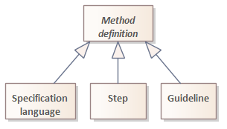
Define method (research question 2)
Existing methods
Under submission
MuDForM
30 years experience
Notes:
What methods exist, what can be used and what issues are not addressed yet.

Slide 21
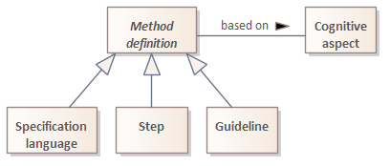
Connect to thought and communication (research question 5)
Cognition perspective on MuDForM
Analysis and reflection of more than 150 books
(language) philosophy, linguistics, cognitive psychology, …
Notes:
Explicitly connect the method ingredients to cognitive aspects, i.e., concepts that the mind uses to think and communicate.

Slide 22
Transform human language into software (research question 3)
Get cash, account balance, privacy
ATM user
Article, law, accountability, traceability
Business model, revenue, interest rate, funding
Government
Business manager
Access location, data entry, help
UI expert
HRM
Employee, training, skill, experience
Asset, measure, harm, vulnerability, attack, certificate
Withdraw money
Security engineer
Project management
from
at
Node, latency, encryption, redundancy server, client
Infrastructure architect
Project, release, milestone, task
Account
ATM
Notes:
The starting point is human language. So, I investigated how humang language can be transformed into something that a computer can process.
This means capturing the vocabulary of all involved people.

Slide 23
Capture decisions in specifications (research question 4)
Art. 4.11
Get cash, account balance, privacy,…
$
ROI
ATM user
t
Article, law, accountability, traceability
Business model, revenue, interest rate, funding
Government
Business manager
Project leader
Software engineer
Tester
Access location, data entry, help
UI expert
HRM
Employee, training, skill, experience
Asset, measure, harm, vulnerability, attack, certificate
Security engineer
Project management
+veel vorige projecten
Node, latency, connection, redundancy, server, client
Infrastructure architect
Project, release, milestone, task
Notes:
With the vocabulary of each party, decisions can be specified.

Slide 24
Effect: specification = software
Art. 4.11
Get cash, account balance, privacy,…
$
ROI
ATM user
t
Article, law, accountability, traceability
Business model, revenue, interest rate, funding
Government
Business manager
Programmer only
translates the method
Project leader
Software engineer
Tester
Access location, data entry, help
UI expert
HRM
Employee, training, skill, experience
Asset, measure, harm, vulnerability, attack, certificate
Security engineer
Project management
Node, latency, connection, redundancy, server, client
Infrastructure architect
Project, release, milestone, task
Notes:
Eveyone is involved in capturing decisions, not just the programmer that makes an unambiguous specification. The job of the programmer becomes a lot easier.

Slide 25
Introduction, vision → Ch1
Ch2
Ch3
Under submission
Ch4
Ch5
Full method definition, background data, and case studies on: https://github.com/robertdeckers/MuDForM
Report: Cognitive perspective on MuDForM
Ch6
Conclusion, discussion, open issues → Ch7

Slide 26
Thank you

